Slide 1
Operator Overloading
Polymorphism in C++

Slide 2
Operator Overloading
Operator Overloading allows a programmer to define new types from the built-in types.
Operator Overloading is useful for redefining built-in operations for user defined types.
Operator Overloading should be used to perform the same function or similar function on class objects as the built-in behavior.
Overloading an operator does not change:
the operator precedence,
the associativity of the operator,
the arity of the operator, or
the meaning of how the operator works on objects of built-in types.

Slide 3
Operator Overloading
Each individual operator must be overloaded for use with user defined types.
Overloading the assignment operator and the subtraction operator does not overload the -= operator.
Operator Overloading enables to apply standard operators (such as +,-,*,<, and so on) to objects of the programmer defined type.
It helps to enhance simplicity in program structure.
Function name
operator+
int a = b + c;
int data type
Calling Party
L-Value
int data type
Argument to function
R-Value , Called Party
Returns an int
Stored in a

Slide 4
Operator Overloading
What?
an operator that has multiple meanings
varies depending on use
Why? Ease of use is a principle of OO
How? by defining as an operator function
functions that can extend meaning of built-in operators (cannot define your own new operators)
keyword operator is in definition, followed by the operator to be overloaded
Used
method syntax or operator syntax
s1.operator>(s2) vs. s1 > s2

Slide 5
Why Operation Overloading
makes statements more intuitive and readable.
for example:
Date d1(12,3,1989);
Date d2;
d2.add_days(d1,45);
// can be written with the + operator as
d2=d1+45;
Extension of language to include user-defined types
I.e., classes
Make operators sensitive to context
Generalization of function overloading

Slide 6
Restrictions on Overloading
The order of precedence cannot be changed for overloaded operators.
Default arguments may not be used with overloaded operators
New operators cannot be created
Overloading must be explicit, i.e. overloading + does not imply += is overloaded

Slide 7
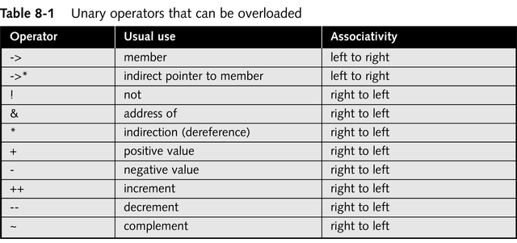
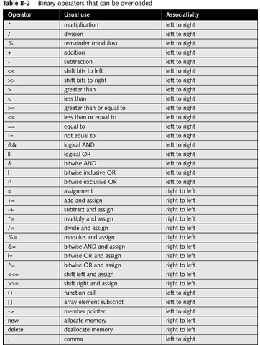
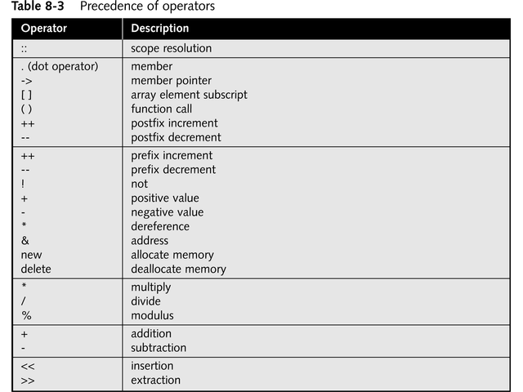

Slide 8
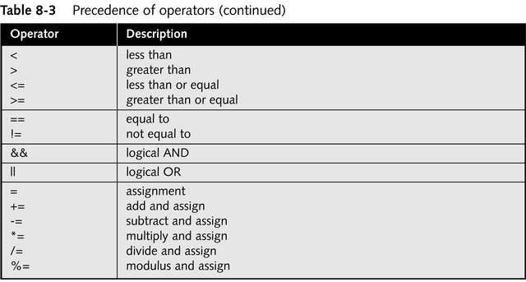
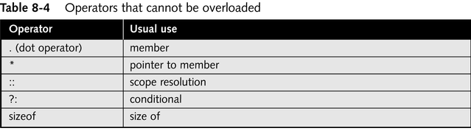
Cont..

Slide 9
Operator Functions
Operator functions may be defined as either member functions or as non-member functions.
Non-member functions are usually made friends for performance reasons.
Member functions usually use the this pointer implicitly.
Syntax:
returnType operator*(parameters);
↑ ↑ ↑ any type keyword operator symbol
Return type may be whatever the operator returns
Including a reference to the object of the operand
Operator symbol may be any overloadable operator from the list.

Slide 10
Cont..
The operator overloading functions for overloading (), [], -> or the assignment operators must be declared as a class member.
All other operators may be declared as non-member functions.
Operator overload function is a function just like any other
Can be called like any other – e.g.,
a.operator+(b)
C++ provides the following short-hand
a+b
If operator overload function is declared global then
operator+(a, b)
also reduces to the following short-hand
a+b

Slide 11
Cont..
To use any operators on a class object, …
The operator must be overloaded for that class.
Three Exceptions: {overloading not required}
Assignment operator (=)
Memberwise assignment between objects
Dangerous for classes with pointer members!!
Address operator (&)
Returns address of the object in memory.
Comma operator (,)
Evaluates expression to its left then the expression to its right.
Returns the value of the expression to its right.

Slide 12
Operator Functions as Class Members
Leftmost operand must be of same class as operator function.
Use this keyword to implicitly get left operand argument.
Operators (), [], -> or any assignment operator must be overloaded as a class member function.
Called when
Left operand of binary operator is of this class.
Single operand of unary operator is of this class.

Slide 13
Operator Functions as Global Members
Need parameters for both operands.
Can have object of different class than operator.
Can be made a friend to access private or protected data.
Stream Insertion and Extraction Operators as Global Functions
Overload << operator used where
Left operand of type ostream &
Such as cout object in cout << classObject
Overload >> has left operand of istream &
Left operand of type istream &
Such as cin object in cout >> classObject
Reason:–
These operators are associated with class of right operand

Slide 14
Cont..
May need + to be commutative
So both “a + b” and “b + a” work as expected.
Suppose we have two different classes
Overloaded operator can only be member function when its class is on left.
HugeIntClass + long int
Can be member function
For the other way, you need a global overloaded function.
long int + HugeIntClass

Slide 15
Example
<< and >> operators
Already overloaded to process each built-in type (pointers and strings).
Can also process a user-defined class.
Overload using global, friend functions
Example program
Class PhoneNumber
Holds a telephone number
Prints out formatted number automatically.
(123) 456-7890

Slide 16
Cont..
// Overloading the stream-insertion and stream-extraction operators.
#include <iostream>
using std::cout;
using std::cin;
using std::endl;
using std::ostream;
using std::istream;
#include <iomanip>
using std::setw;
// PhoneNumber class definition
class PhoneNumber {
friend ostream &operator<<( ostream&, const PhoneNumber & );
friend istream &operator>>( istream&, PhoneNumber & );
private:
char areaCode[ 4 ]; // 3-digit area code and null
char exchange[ 4 ]; // 3-digit exchange and null
char line[ 5 ]; // 4-digit line and null
}; // end class PhoneNumber
Notice function prototypes for overloaded operators >> and <<
They must be non-member friend functions, since the object of class Phonenumber appears on the right of the operator.
cin >> object cout<< object

Slide 17
Cont..
// overloaded stream-insertion operator; cannot be
// a member function if we would like to invoke it with
// cout << somePhoneNumber;
ostream &operator<<( ostream &output, const PhoneNumber &num )
{
output << "(" << num.areaCode << ") "
<< num.exchange << "-" << num.line;
return output; // enables cout << a << b << c;
} // end function operator<<
// overloaded stream-extraction operator; cannot be a member function if we would like to invoke it with
// cin >> somePhoneNumber;
istream &operator>>( istream &input, PhoneNumber &num )
{
input.ignore(); // skip (
input >> setw( 4 ) >> num.areaCode; // input area code
input.ignore( 2 ); // skip ) and space
input >> setw( 4 ) >> num.exchange; // input exchange
input.ignore(); // skip dash (-)
input >> setw( 5 ) >> num.line; // input line
return input; // enables cin >> a >> b >> c;
} // end function operator>>
The expression: cout << phone; is interpreted as the function call: operator<<(cout, phone);
output is an alias for cout.
This allows objects to be cascaded. cout << phone1 << phone2; first calls operator<<(cout, phone1), and returns cout. Next, cout << phone2 executes.
ignore() skips specified number of characters from input (1 by default).
Stream manipulator setw restricts number of characters read. setw(4) allows 3 characters to be read, leaving room for the null character.

Slide 18
int main()
{
PhoneNumber phone; // create object phone
cout << "Enter phone number in the form (123) 456-7890:\n";
// cin >> phone invokes operator>> by implicitly issuing
// the non-member function call operator>>( cin, phone )
cin >> phone;
cout << "The phone number entered was: " ;
// cout << phone invokes operator<< by implicitly issuing
// the non-member function call operator<<( cout, phone )
cout << phone << endl;
return 0;
} // end main
Enter phone number in the form (123) 456-7890:
(800) 555-1212
The phone number entered was: (800) 555-1212

Slide 19
Unary Operators
The unary operators operate on the object for which they were called and normally, this operator appears on the left side of the object, as in !obj, -obj, and ++obj but sometime they can be used as postfix as well like obj++ or obj--.
Can overload as
Non-static member function with no arguments.
As a global function with one argument.
Argument must be class object or reference to class object.
Why non-static?
static functions only access static data
Not what is needed for operator functions

Slide 20
Example: Integer Class
#include <iostream>
using namespace std;
// Non-member functions
class Integer
{
long i;
Integer* This()
{
return this;
}
public:
Integer(long ll = 0) : i(ll) {}
// No side effects takes const& argument:
friend const Integer& operator+(const Integer& a);
friend const Integer operator-(const Integer& a);
friend const Integer operator~(const Integer& a);
friend Integer* operator&(Integer& a);
friend int operator!(const Integer& a);
// Side effects have non-const& argument:
friend const Integer& operator++(Integer& a); // Prefix
friend const Integer operator++(Integer& a, int); // Postfix
friend const Integer& operator--(Integer& a); // Prefix
friend const Integer operator--(Integer& a, int); // Postfix
};

Slide 21
// Global operators:
const Integer& operator+(const Integer& a)
{
cout << "+Integer\n";
return a; // Unary + has no effect
}
const Integer operator-(const Integer& a)
{
cout << "-Integer\n";
return Integer(-a.i);
}
const Integer operator~(const Integer& a)
{
cout << "~Integer\n";
return Integer(~a.i);
}
Integer* operator&(Integer& a)
{
cout << "&Integer\n";
return a.This(); // &a is recursive!
}
int operator!(const Integer& a)
{
cout << "!Integer\n";
return !a.i;
}
// Prefix; return incremented value
const Integer& operator++(Integer& a)
{
cout << "++Integer\n";
a.i++;
return a;
}
// Postfix; return the value before increment:
const Integer operator++(Integer& a, int)
{
cout << "Integer++\n";
Integer before(a.i);
a.i++;
return before;
}
// Prefix; return decremented value
const Integer& operator--(Integer& a)
{
cout << "--Integer\n";
a.i--;
return a;
}
// Postfix; return the value before decrement:
const Integer operator--(Integer& a, int)
{
cout << "Integer--\n";
Integer before(a.i);
a.i--;
return before;
}

Slide 22
// Show that the overloaded operators work:
void f(Integer a)
{
+a;
-a;
~a;
Integer* ip = &a;
!a;
++a;
a++;
--a;
a--;
}
const Byte operator-() const
{
cout << "-Byte\n";
return Byte(-b);
}
const Byte operator~() const
{
cout << "~Byte\n";
return Byte(~b);
}
Byte operator!() const
{
cout << "!Byte\n";
return Byte(!b);
}
Byte* operator&()
{
cout << "&Byte\n";
return this;
}
// Member functions (implicit "this"):
class Byte
{
unsigned char b;
public:
Byte(unsigned char bb = 0) : b(bb) {}
// No side effects: const member function:
const Byte& operator+() const
{
cout << "+Byte\n";
return *this;
}

Slide 23
// Side effects: non-const member function:
const Byte& operator++() // Prefix
{
cout << "++Byte\n";
b++;
return *this;
}
const Byte operator++(int) // Postfix
{
cout << "Byte++\n";
Byte before(b);
b++;
return before;
}
const Byte& operator--() // Prefix
{
cout << "--Byte\n";
--b;
return *this;
}
const Byte operator--(int) // Postfix
{
cout << "Byte--\n";
Byte before(b);
--b;
return before;
}
};
void g(Byte b)
{
+b;
-b;
~b;
Byte* bp = &b;
!b;
++b;
b++;
--b;
b--;
}
int main()
{
Integer a;
f(a);
Byte b;
g(b);
}

Slide 24
Overloading Binary Operators
Non-static member function with one argument.
return_type operator symbol(R-Value);
or
Global function with two arguments:
One argument must be class object or reference to a class object.
return_type operator symbol(L-Value, R-Value);
This is the mechanism by which the compiler prevents you from redefining built-in operations!

Slide 25
Overloading Binary Operators
If a non-static member function, it needs one argument.
class String { public: String & operator+=( const String &); … };
By shorthand rule
y += z becomes y.operator+=( z )

Slide 26
Cont..
If a global function, it needs two arguments
class String { public: String & operator+=( String &, const String & ); … };
By short-hand rule
y += z becomes operator+=(y, z)

